Slide 1
Surface Pressure and Wind Patterns

Slide 2
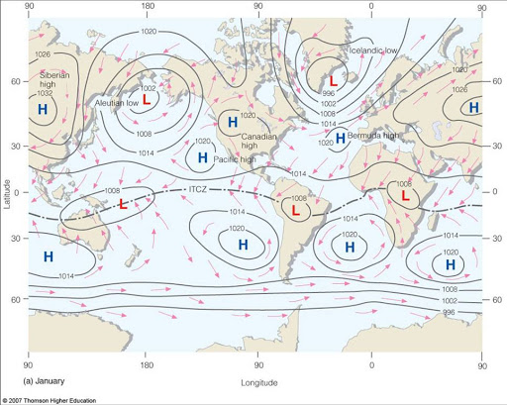
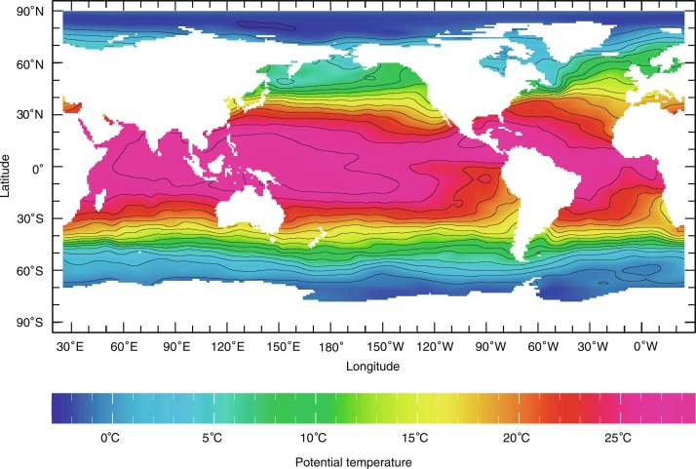
Pressure Gradient
Winds at the surface exist due to pressure gradients at various scales.
Pressure gradients exist due to features such as spatial temperature differences.
Other features also play a role (i.e., topography), which means pressure, temperature, and wind may not always perfectly align.

Slide 3
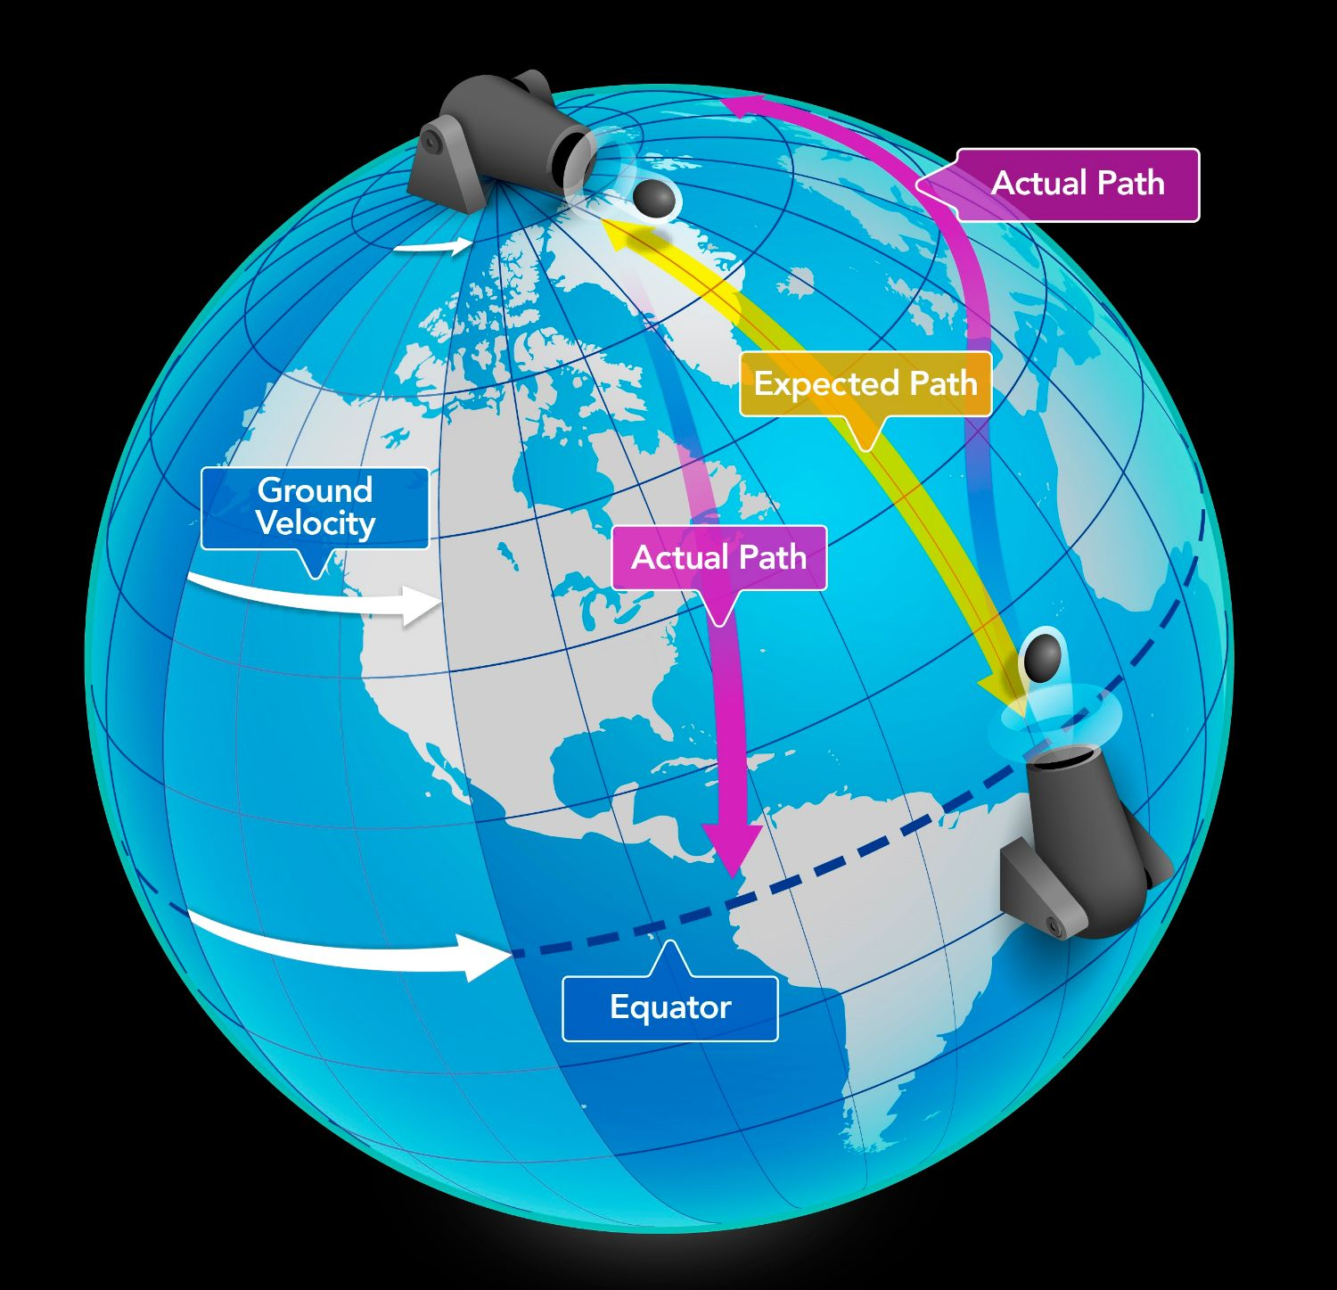
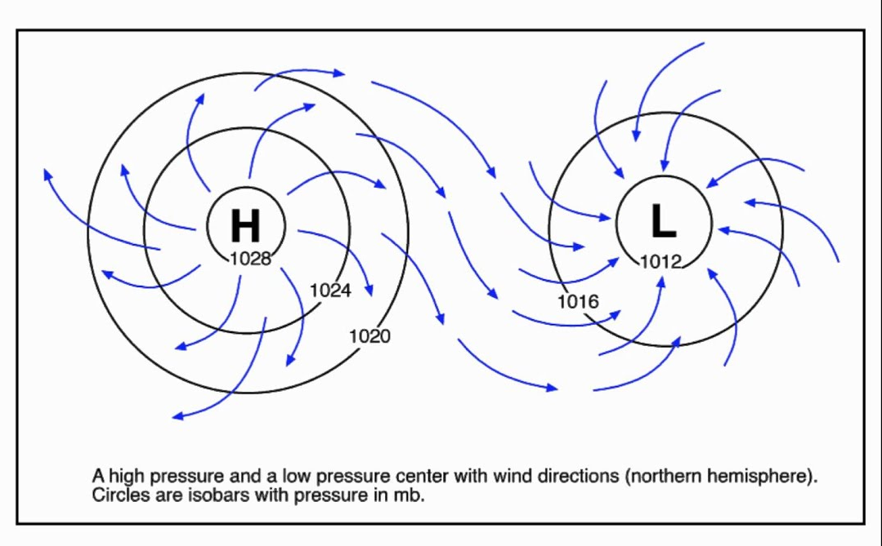
Coriolis and Friction
Due to Coriolis and Friction, surface winds “curve” as the air moves from high to low pressure.
This curvature is relative and exists due to the rotation of the Earth.

Slide 4
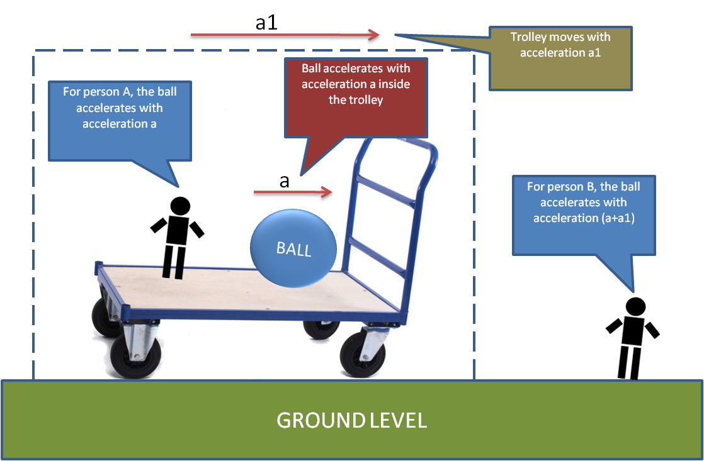
Two Reference Frames
Remember that we (the observer) are ON the Earth, while the air is ABOVE the Earth. Two different reference frames.
Imagine watching someone throwing a ball inside a moving car while you’re standing still watching the car drive by.

Slide 5
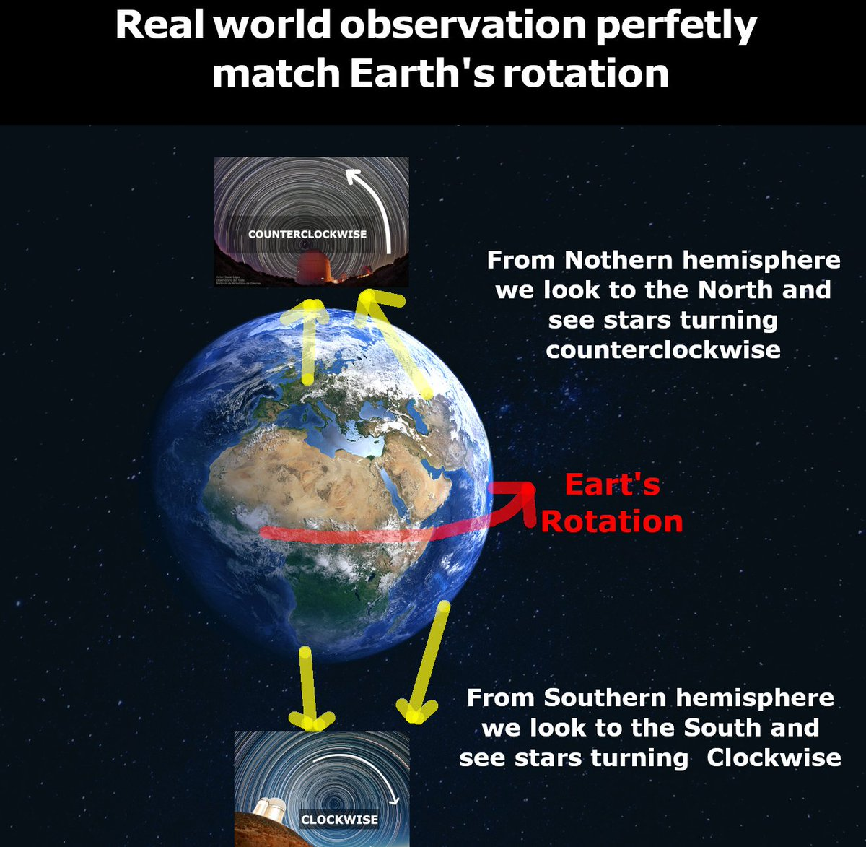
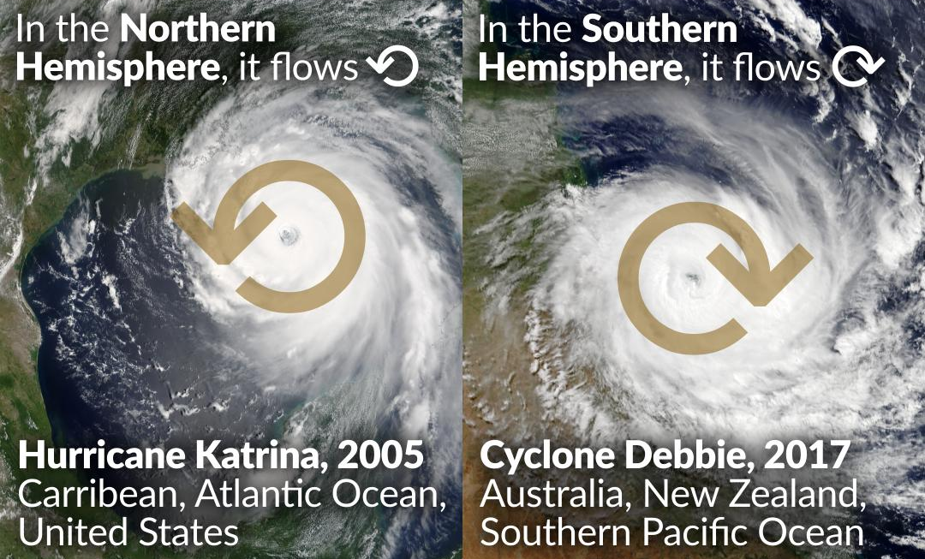
Different Types of Wind Patterns
In general, air flows in a cyclonic direction (counter-clockwise in the Northern Hemisphere) around surface low pressures and flows in an anti-cyclonic direction (clockwise in the Northern Hemisphere) around surface high pressures.
Backwards in the Southern Hemisphere since a person would be oriented upside-down!
Earth’s
Hurricanes and Cyclones are viewed the same as star gazing due to Earth’s Rotation

Slide 6
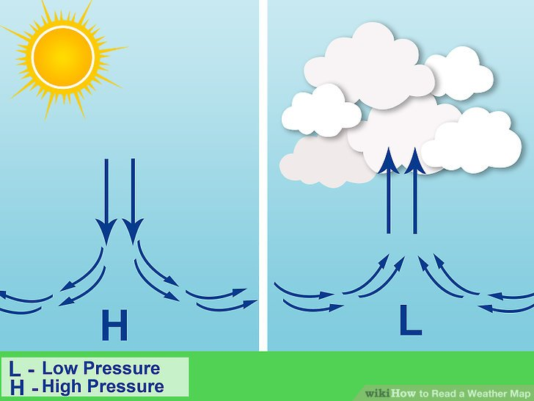
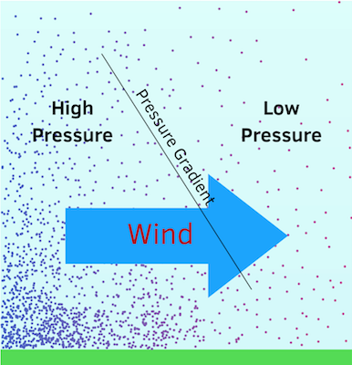
Surface Pressure
Meteorologists use surface pressure and wind maps as a guide for locating the position of certain types of weather:
Precipitation and clouds are usually associated with low pressure.
Clear skies are usually associated with high pressure.

